Slide 1


Zomato Restaurants Analysis
Data-Driven Restaurant Expansion Strategy
Gayatri Kumari

Slide 2

INTRODUCTION
The global restaurant industry is dynamic and competitive, with customer expectations constantly shifting.
As a key player, Zomato aims to use data insights to make informed decisions about market expansion and service improvements.
The project analyzes real-world restaurant data to uncover valuable trends and support strategic planning to open newer restaurants across the globe.

Slide 3
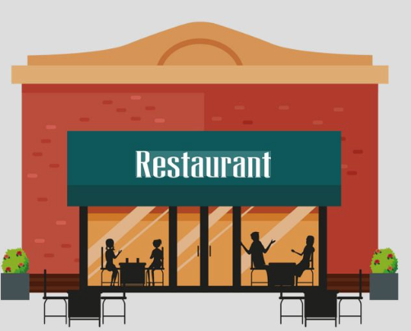
Objectives
Identify countries and cities where there is less competition and a greater chance of new restaurant openings.
Analyze market trends like pricing, customer rating, online delivery, and table booking preferences.
Examine the impact of price and cuisine varieties on customer ratings.
Deliver data-based suggestions to open newer restaurants.

Slide 4
Problem Statement
Zomato operates in a highly competitive global restaurant market.
Customer preferences and satisfaction vary across regions.
Identifying a low-competition, high-growth market is challenging.
Factors like pricing, cuisine, delivery, and booking impact performance.
Data-driven insights are essential for effective expansion decisions.

Slide 5

Zomato Restaurants Data(Data Overview)
Countries Covered: 15 countries across the globe.
Cities Included: 141 cities spanning these countries.
Total Number of Restaurants: 9,551 restaurants listed across 15 global countries and 141 cities.
Variety of cuisines offered: 1826 different cuisines reflecting global food diversity.
Opening Date: Shows when the restaurant started operations.
Online Delivery: Indicates whether online food delivery is available.
Table Booking: Shows if table reservations can be made.
Average Cost for Two: Approximate cost for two people dining together.
Customer Ratings: Reflects customer feedback on a scale(1-5).
Price Range: Categorizes restaurants into affordability level(1-4).

Slide 6
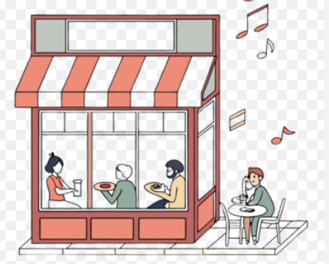
Data Cleaning Steps
Filled missing values in the Cuisine column (USA) with “American” based on highest frequency
Corrected all incorrect entries in the City column.
Replaced zero values in Average_Cost_for_Two with the country-wise average cost.
Corrected currency values and updated them with proper currency symbols.
Converted Datekey_Opening f filed into a standard date format(DD-MM-YYYY).
Extracted Year from the converted date column for the further analysis.
Created two additional columns “Average_Cost_For_two(INR)” and “CompetitionLevel” for deeper insights.

Slide 7

Methodology
Data Preparation: Cleaned the dataset by removing duplicates, fixing missing values, and standardizing inconsistent entries.
Data Enhancement: Applied XLOOKUP to map the country name using country codes, and extracted new fields like the Year of Opening from the date column.
Data Formatting: Reformatted the ‘Datekey_Opening’ using TEXT and DATE functions. Derived year using the YEAR function for yearly trend analysis.
Trend Analysis to study restaurant growth over time.
Descriptive Statistics for rating, votes, and average costs.
Correlation Analysis to evaluate the impact of price, rating, and delivery.

Slide 8


Methodology
Excel Tools & Functions Used:
Pivot Tables for summaries by country and city.
Conditional Formatting to highlight high/low performers.
Logical Functions like IF, AND, and OR to filter insights.
Array Formulas for counting based on multiple conditions.
Visualization: Created charts such as bar graphs, pie charts, Scatter plots, and trend lines to clearly present insights and support recommendations.

Slide 9
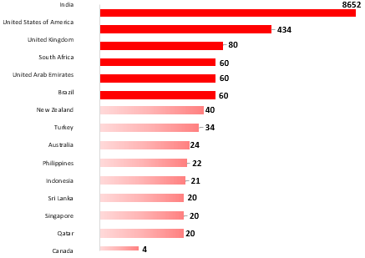
Identifying Potential Markets
Total Restaurants per Country
Red bars are highly competitive markets.
Light Red bars are low-competitive markets.
India(8652) and the USA(434) show high competition.
Canada, Qatar, Singapore, Sri Lanka, Indonesia, the Philippines, Australia, Turkey, and New Zealand have very low competition. So, they are the potential markets.
Low-competitive markets offer first-mover advantages, lower marketing costs, easier customer acquisition, and faster growth and brand awareness.

Slide 10
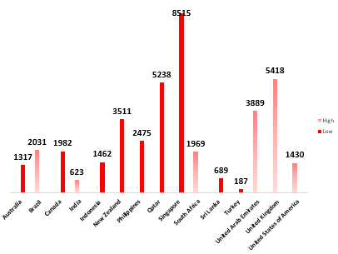
Customer Engagement by Country
Average Vote per Country
Indonesia leads with the highest average votes(772), indicating strong customer engagement.
UAE(494), Turkey(431), USA(428), and Philippines(407) also shows high customer activity.
Brazil(20) and Singapore(32) have very low engagement, suggesting a newer or less active market.
India, despite having the most restaurants, shows moderate engagement with 137 average votes.
Indonesia, Turkey, and the Philippines are the countries with high customer satisfaction and low competition. Making them strong markets for new restaurant expansion.

Slide 11
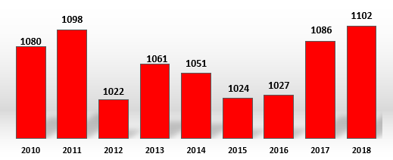
Trend of Restaurant Openings
Restaurant openings grew steadily from 2010 to 2011 and peaked in 2018(1102).
There was a dip in the trend in 2012(1022), followed by ups and downs.
A strong and steady growth in the trend is seen after 2016, indicating renewed market interest.
So, this shows that this is the right time to open newer restaurants.
This growing trend shows a positive sign for us.

Slide 12
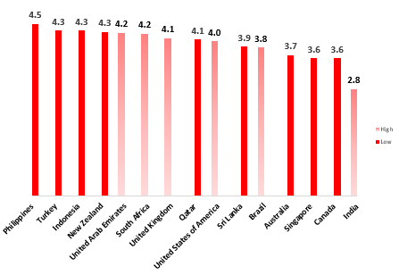
Customer Satisfaction by Country
Average Rating Per Country
Red bars are highly competitive markets.
Light Red bars are Low competitive markets.
Philippines (4.4) and Indonesia (4.3) has high average customer ratings, indicating high customer satisfaction and quality.
India (2.8), despite having the most restaurants, has a comparatively low rating, suggesting quality issues.
UK (4.0), USA (3.9), Turkey (4.1), and New Zealand (4.2) show consistently good ratings.
Brazil (2.1) and Qatar (2.4) have the lowest average ratings, indicating poor customer experience and lack of quality.
Countries with low ratings and low competition can be ideal for opening newer restaurants

Slide 13
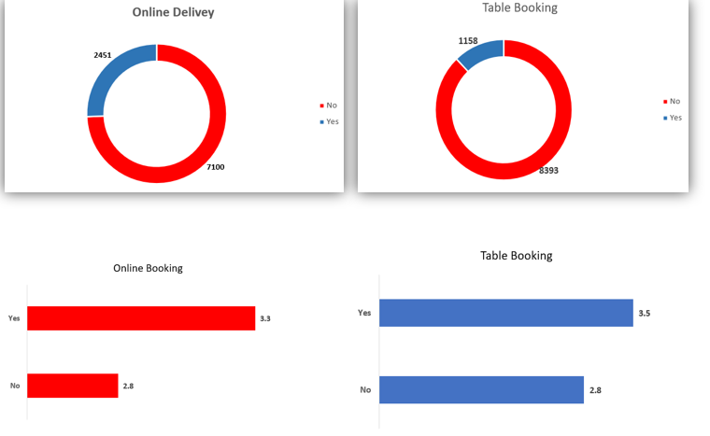
Impact of Delivery & Booking on Rating
Average Rating per Feature
Red bars indicate availability of the feature.
The blue bar indicates the unavailability of the feature.
Online Delivery availability has an average rating of 3.3 over 2451 restaurants, and unavailability has an average rating of 2.8 over 7100 restaurants.
Table Booking availability has average rating of 3.5 over 1158 restaurants and unavailability has average rating of 2.8 over 8393 restaurants.
Providing both delivery and booking options is strongly impacts higher rating.

Slide 14

Food Expenditure by Country
Average Cost for Two(in INR)
Light Red bars are highly competitive markets
Red bars are low-competitive markets
Qatar, Singapore, and the United Arab Emirates have the highest average food expenditure, unsuitable for high-end restaurants.
India and Brazil show lower average food costs, which shows budget-conscious customer behavior.
Moderate pricing is seen in countries like the USA, UK, Canada, and Australia, suggesting affordability
Countries with Food expenditure below the average and low competition can be ideal for opening newer restaurants
“Average Food Expenditure(INR) for two among competitors: 2819”

Slide 15
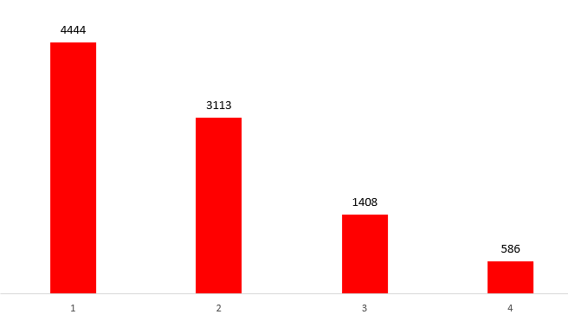
Restaurant Distribution by Price Range
Most restaurants fall under the price range 1 category – 4444 restaurants. Indicates a highly budget-efficient restaurant across the globe.
Mid mid-range option is the Prince Range 2 are the second most common – 3113 restaurants.
High-end restaurants’ price-Range are 3 & 4 are much lower than 1408 and 586, respectively.
The majority of restaurants are clustered in affordable ranges, suggesting price is a major factor influencing the success.

Slide 16
Country and City Recommendations
COUNTRIES
CITIES
CUSINES
Australia
Canada
Indonesia
Turkey
Sri Lanka
Philippines
New Zealand
Qatar
Singapore
Montville(Australia)
Chatham-Kent(Canada)
Bogor(Indonesia)
Ankara(Turkey)
Istanbul(Turkey)
Colombo( Sri Lanka)
San Juan City(Philippines)
Auckland(New Zealand)
Wellington(New Zealand)
Doha (Qatar)
Singapore(Singapore)
Pizza, Bar Food(Australia)
Italian, Mediterranean, Pizza(Canada)
Sunda, Indonesia(Indonesia)
Bar Food(Turkey)
Sea Food(Sri Lanka)
European, Asian, Indian(Philippines)
Desserts(New Zealand)
Chinese(Qatar)
Italian(Singapore)
“I highly suggest these countries and cities in the criteria of low competitors, high popularity, and low rating & cuisines based on popularity and high rating. This way, by opening high-quality restaurants in these cities, we can attract the existing customer base and stand out from poor-performing competitors.”

Slide 17
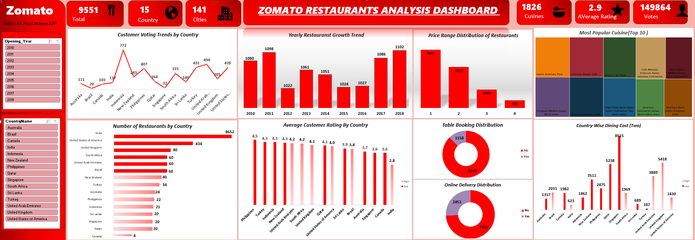
Dashboard

Slide 18
DASHBOARD FEATURES AND INTERPRETABILITY
Features:
Interpretability:
Filters for Country and Opening Year to explore specific markets and trends.
KPI: Total Restaurants, Countries, Cities, Cuisines, Average Rating, and Votes.
Data Visualizations: Bar Charts, Trend Lines, Donut Charts, and Tree Maps for deep insights.
Home Button: Navigates to Pivot Tables.
Data Button: Navigates to Raw Dataset.
Market Competition chart uses color coding to show High(Red) and Low(Green) competition.
Restaurant Opening Trend Charts help identify growth periods of restaurants.
Delivery & Table Booking impact charts highly on how features influence customer satisfaction.
Cuisine Popularity Map shows the top food preference by Votes.
Restaurants Distribution by Price range assists in identifying affordable vs. premium market focus.

Slide 19
Conclusion
High competition in India and the USA, and Low Competition in countries like Canada, Qatar, and Sri Lanka are ideal for new market entry.
Online delivery and table booking positively impact ratings, enhancing customer experience.
The majority of restaurants fall under affordable price ranges, highlighting a large number of budget-efficient restaurants.
Italian, American, and Pizza cuisines dominate in popularity by votes.
Steady growth in restaurant opening, with a sharp rise after 2016, indicates a booming market in the restaurant business.
“This analysis supports data-driven choices for strategic positioning, service optimization, and market expansion in the international sector.”

Slide 20
Thank You
Gayatri Kumari

